Slide 1
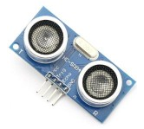
Ultrasonic
Yao-Tung Tsou
Notes:
http://www.modmypi.com/blog/hc-sr04-ultrasonic-range-sensor-on-the-raspberry-pi
http://www.raspberrypi-spy.co.uk/2012/12/ultrasonic-distance-measurement-using-python-part-1/
http://atceiling.blogspot.tw/2014/03/raspberry-pi_18.html#.Vi-G-WvXp9A

Slide 2
Ultrasonic Robot
https://www.youtube.com/watch?v=t3kXWSctj2Q

Slide 3
Introduction
Ultrasonic allows you to measure the distance to the nearest wall or solid object.
The modules are easy to buy, cheap and relatively straight forward to interface to the GPIO header.

Slide 4
Introduction
Sound consists of oscillating waves through a medium (such as air) with the pitch being determined by the closeness of those waves to each other, defined as the frequency.
Only some of the sound spectrum (the range of sound wave frequencies) is audible to the human ear, defined as the “Acoustic” range. Very low frequency sound below Acoustic is defined as “Infrasound”, with high frequency sounds above, called “Ultrasound”.

Slide 5
Introduction
Ultrasonic sensors are designed to sense object proximity or range using ultrasound reflection, similar to radar, to calculate the time it takes to reflect ultrasound waves between the sensor and a solid object.
Ultrasound is mainly used because it’s inaudible to the human ear and is relatively accurate within short distances.
You could of course use Acoustic sound for this purpose, but you would have a noisy robot, beeping every few seconds. . . .

Slide 6
Introduction
A basic ultrasonic sensor consists of one or more ultrasonic transmitters (basically speakers), a receiver, and a control circuit.
The transmitters emit a high frequency ultrasonic sound, which bounce off any nearby solid objects.
Some of that ultrasonic noise is reflected and detected by the receiver on the sensor.
That return signal is then processed by the control circuit to calculate the time difference between the signal being transmitted and received.
This time can subsequently be used, along with some clever math, to calculate the distance between the sensor and the reflecting object.

Slide 7
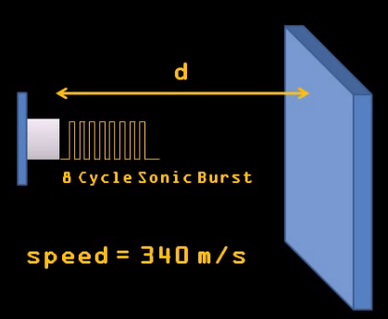
Introduction
Notes:
https://www.youtube.com/watch?v=xACy8l3LsXI

Slide 8
We need
HC-SR04
1kΩ Resistor
2kΩ Resistor
Jumper Wires

Slide 9
HC-SR04
Specifications
Working voltage: 5V DC
Ranging: 2cm-500cm
Resolution: 0.3cm
Frequency: 40kHz
Cycle Period: 50ms

Slide 10
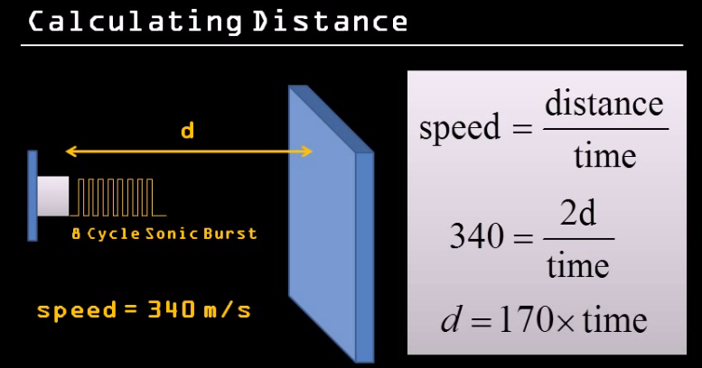
Calculate Distance
Distance= (differential time between transmitting and receiving*sound speed(340m/s))/2

Slide 11
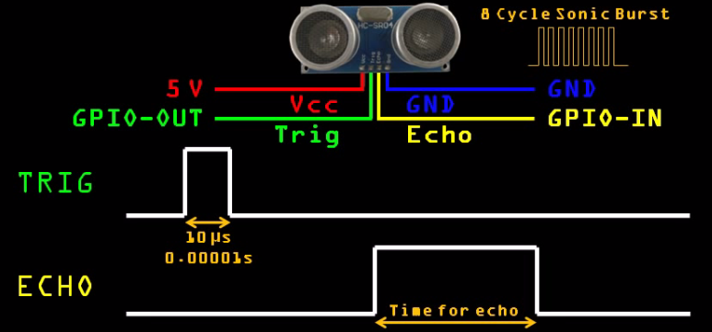
How It Works
is Proportional to how far away the object is

Slide 12
Connecting to the Pi
Powering the module is easy. Just connect the +5V and Ground pins to Pin 2 and Pin 6 on the Pi’s GPIO header.
The input pin on the module is called the “trigger” as it is used to trigger the sending of the ultrasonic pulse.
Ideally it wants a 5V signal but it works just fine with a 3.3V signal from the GPIO. So I connected the trigger directly to Pin 16 (GPIO23) on my GPIO header.
You can use any GPIO pins you like on your RPi but you will need to note the references and amend your Python script accordingly.

Slide 13
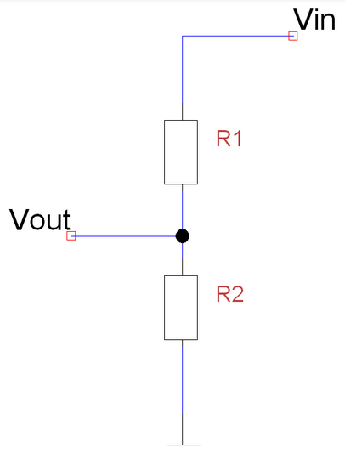
Voltage Dividers
A voltage divider consists of two resistors (R1 and R2) in series connected to an input voltage (Vin), which needs to be reduced to our output voltage (Vout).
In our circuit, Vin will be ECHO, which needs to be decreased from 5V to our Vout of 3.3V.

Slide 14
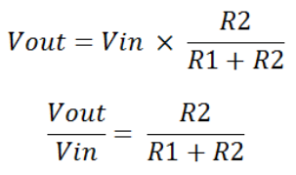
Voltage Dividers
The following circuit and simple equation can be applied to many applications where a voltage needs to be reduced.
If you don’t want to learn the techy bit, just grab 1 x 1kΩ and 1 x 2kΩ resistor.

Slide 15
Voltage Dividers
Without getting too deep into the math side, we only actually need to calculate one resistor value, as it’s the dividing ratio that’s important.
We know our input voltage (5V), and our required output voltage (3.3V), and we can use any combination of resistors to achieve the reduction.
For example, I happen to have a bunch of extra 1kΩ resistors, so I decided to use one of these in the circuit as R1.

Slide 16
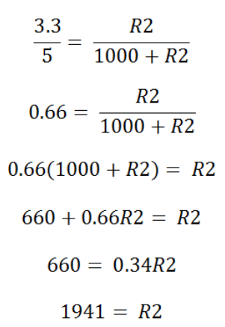
Voltage Dividers
Plugging our values in, this would be the following:
So, we’ll use a 1kΩ for R1 and a 2kΩ resistor as R2!

Slide 17
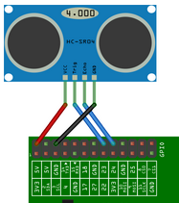
Connecting to the Pi

Slide 18
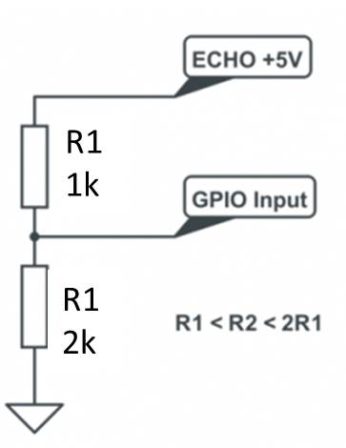
Connecting to the Pi
The module’s output is called the “echo” and needs a bit more thought. The output pin is low (0V) until the module has taken its distance measurement.
It then sets this pin high (+5V) for the same amount of time that it took the pulse to return.
So our script needs to measure the time this pin stays high. The module uses a +5V level for a “high” but this is too high for the inputs on the GPIO header which only like 3.3V.
In order to ensure the Pi only gets hit with 3.3V we can use a basic voltage divider. This is formed with two resistors.

Slide 19
Connecting to the Pi
If R1 and R2 are the same then the voltage is split in half. This would give us 2.5V. If R2 is twice the value of R1 then we get 3.33V which is fine.
So ideally you want R2 to be between R1 and R1 x 2.

Slide 20
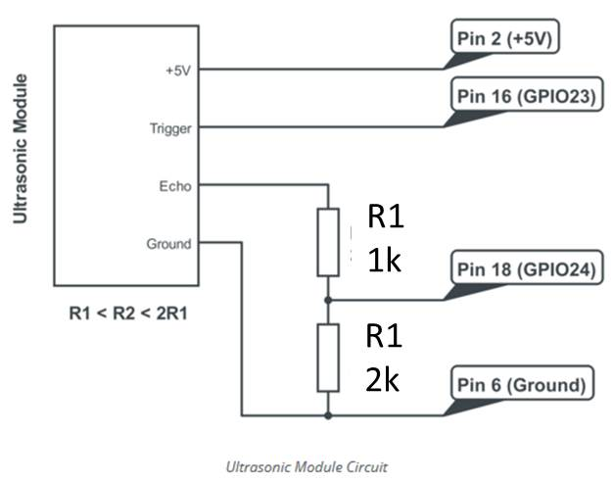
Connecting to the Pi
Here is a diagram of my final circuit. I chose GPIO23 and GPIO24 but you can use any of the 17 available GPIO pins on the GPIO header. Just remember to update the script.

Slide 21
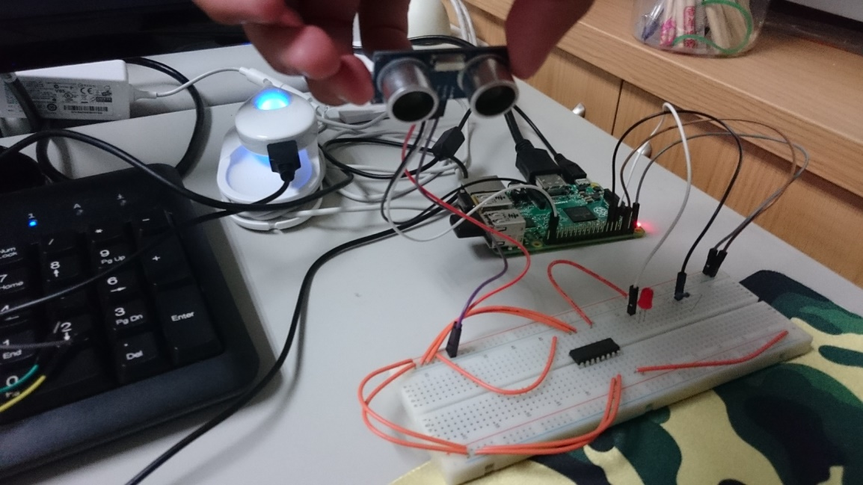
Connecting to the Pi

Slide 22
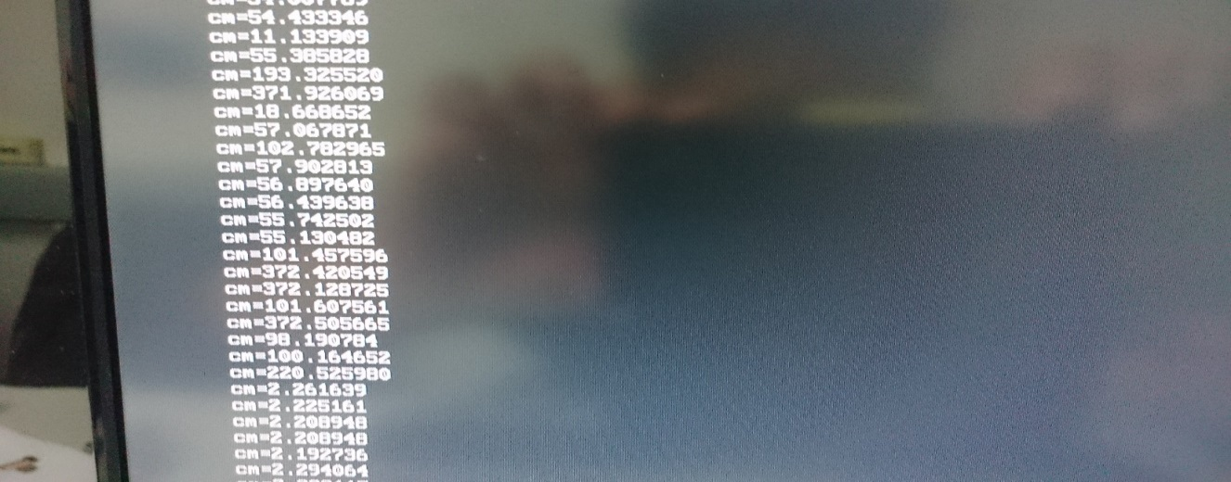
Do by yourself
Writing a code to output the result as follows, but not limited.
Tip: time.time() //record current time

Slide 23
Something you need to know
The accuracy of the distance measurement is dependent on timing. Python under Linux is not ideal for precise timing but for general messing about it will work OK.
To improve accuracy you would need to start looking at using C instead.
When the GPIOs are configured the module needs some time before it is ready to take its first reading so you can add a 0.5 second delay to the start of the script.

Slide 24
Something you need to know
The transducers have a wide angle of sensitivity. In a cluttered environment you may get shorter readings due to objects to the side of the module.
Measurements work down to about 2cm. Below this limit the results can give strange results.
If the ultrasonic transducers touch anything the results are unpredictable.

Slide 25
End

